Slide 1
Face Recognition
Program Structure/Training/Testing

Slide 2
Program Structure
Capture Image for Targeted Face (webcam_v3_capture.py)
Training
Image preprocessing and encoding (facenet_predict3.py)
Image Classifier (mlp.py , knn.py , logistic_regression.py , facenet_network.py)
Classifier Ensemble(voting.py)
Testing/Application (webcam_v3_facenet3.py)

Slide 3
Sampling Sequence
(Optional) Capture image using webcam_v3_capture.py . Image will be output to frame.jpg in the working folder. If it is satisfied, add into img folder but saved with a name distinguishable to other images in the folder.
Enter the name to “images” list below in facenet_predict3.py

Slide 4

Sampling Sequence
In process_csv.py , add the following code so that image encoding can be used to train the classifiers.
At first adding loadtxt command. (The numbering follows sequence in the “images” list

Slide 5
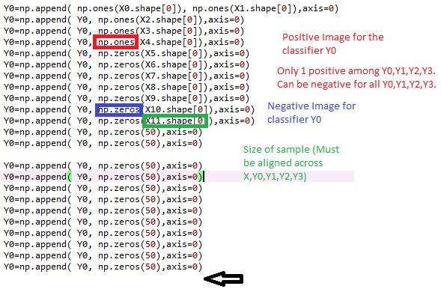
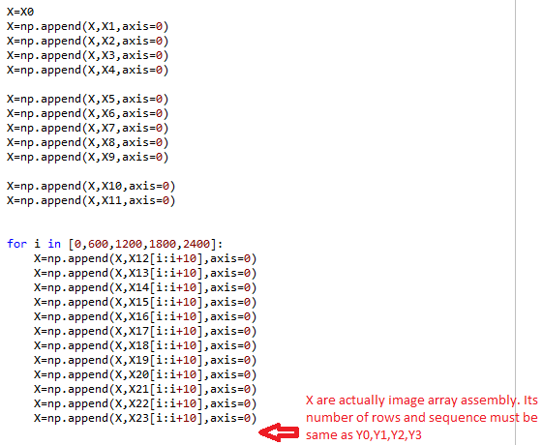
Sampling Sequence
Secondly, in process_csv.py , add the following code so that image expect value can be recognized by mlp.py , knn.py , logistic_regression.py , facenet_network.py and voting.py

Slide 6
Training Sequence
Run the scripts in sequence. (Parallel run allows among scripts at item 2)
Image preprocessing and encoding (facenet_predict3.py)
Image Classifier (mlp.py , knn.py , logistic_regression.py , facenet_network.py)
Classifier Ensemble(voting.py)

Slide 7
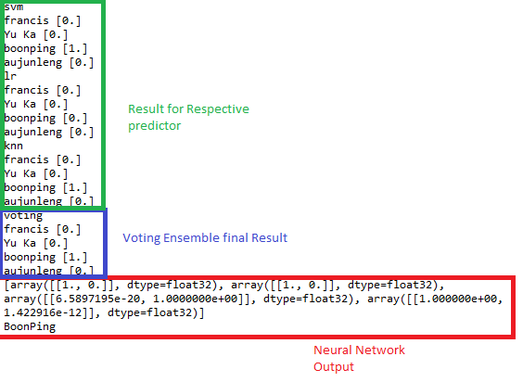
Testing
Run the webcam_v3_facenet3.py
Change opencv video capture setting from”0” to “1” to use external camera
Wait 30s for all the model loadings before usage.
Outputs are in the following example

